Slide 1

Manikya Lal Verma Textile & Eng. College
Q.G. - 11
Submitted To
Mrs. Hareeta Malani
(Project Guide, Asst. ECE Department)
Submitted By
Ashish Sahu
Shubham Sharma
Vishal Yadav
Dharmendra Saini
Santosh Yadav

Slide 2
Advance Security System

Slide 3
Overview
Introduction
Block diagram and flow chart
Simulation
PCB layouts
Implementation

Slide 4
Advance Security System
The aim of our project is to provide privacy and security to a particular Home or companies from remote locations from a central Server system.
the system allows the home owner or company owner to monitor and control the house security like Whose entered, Door lock or door unlocked, which can be switched on or o via the mobile phone set by sending commands in the form of SMS and also the home owner can receive the appliances status.

Slide 5
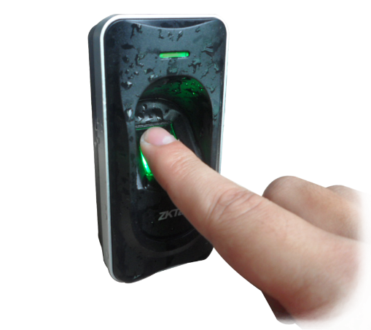
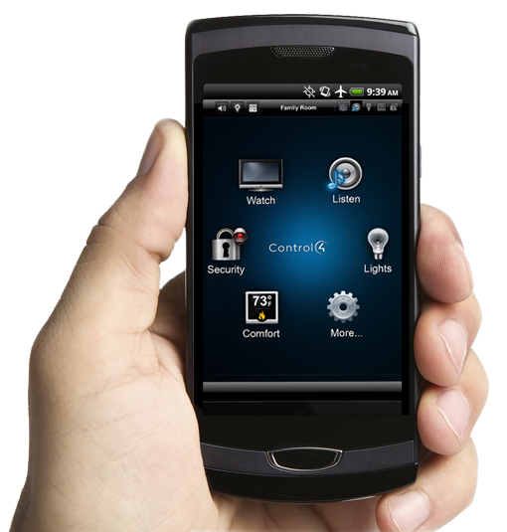
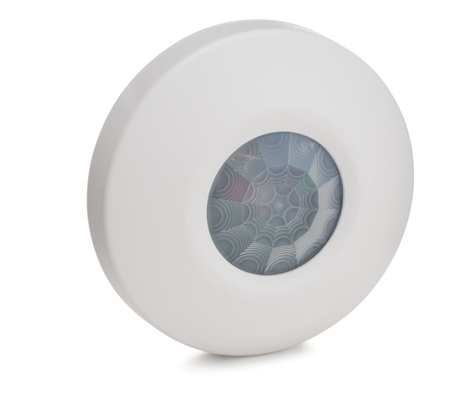
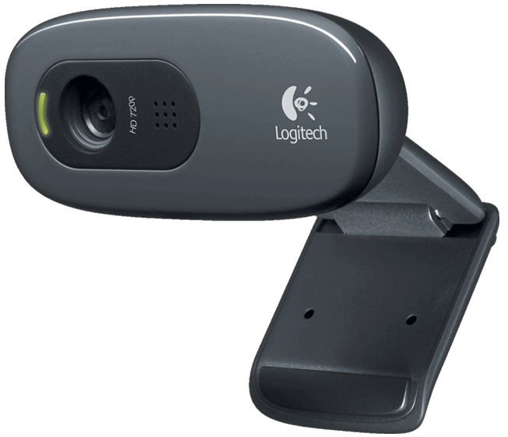
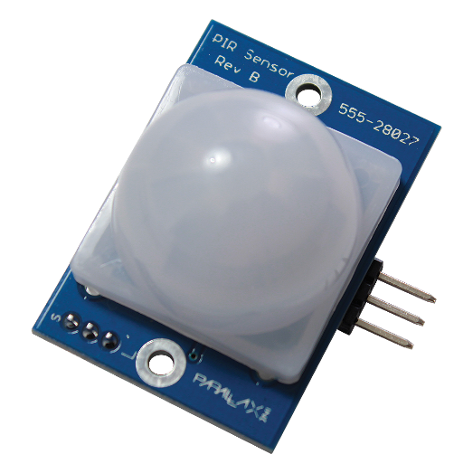

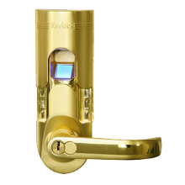

Features
Motion Detector
Web Came
Finger Print Access
Smart Phone Controllable
Light Detector
Door Lock Unlock
All Data Logs
Live Notifications

Slide 6
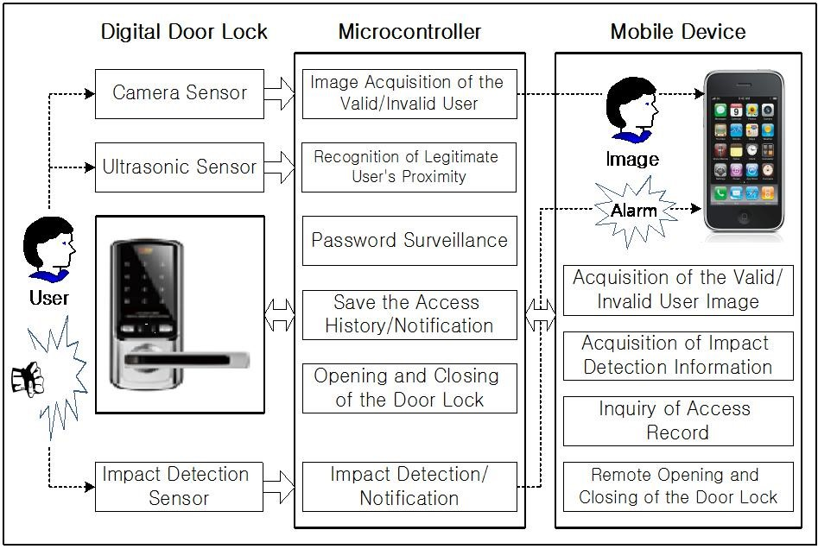
Overall Structure

Slide 7
Modules of Project
1. Survey
2. Study of Software and Hardware
3. Design of the Advance Security System
4. Implementation

Slide 8
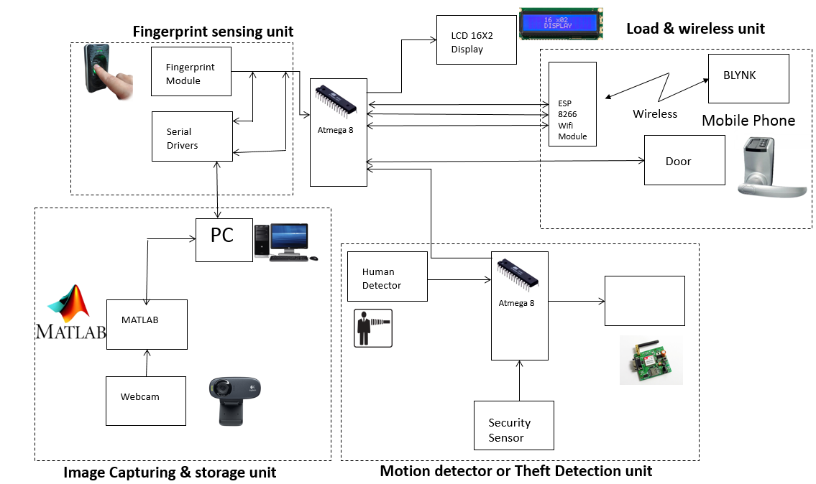
Block Diagram

Slide 9
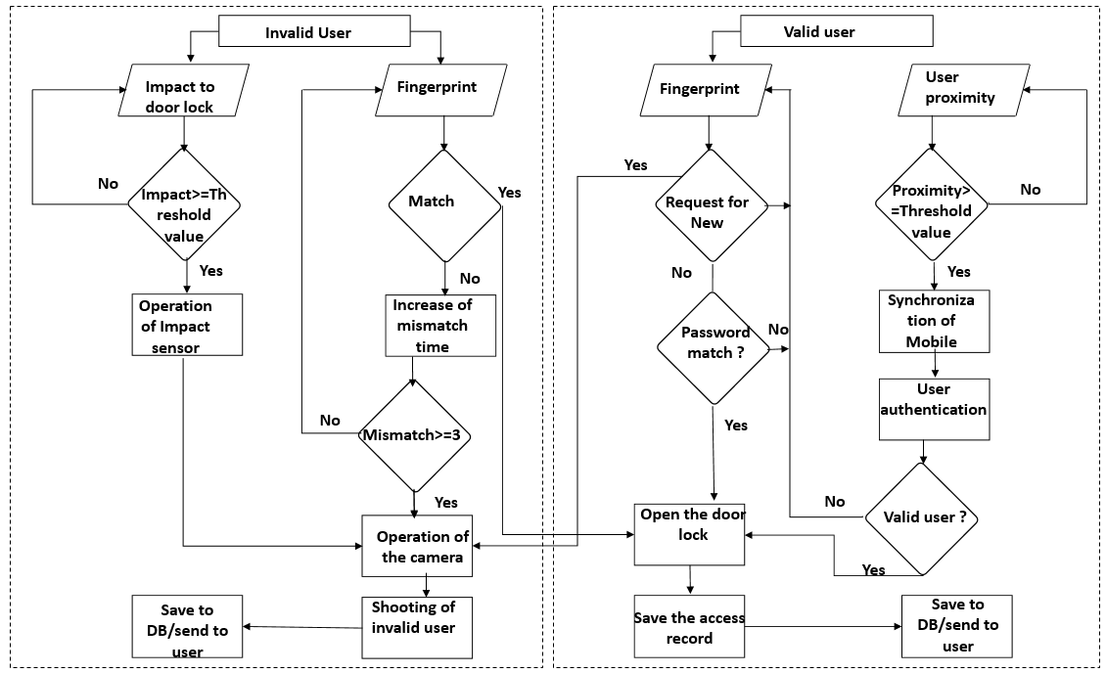
Flow Chart

Slide 10
Algorithm
STEP 1 : START
STEP 2 : FOR each user
STEP 3 : INPUT Action
STEP 4 : SWITCH Action
STEP 5 : CASE “fingerprint”
STEP 6 : IF fingerprint does not match THEN take and send image
STEP 7 : ELSE IF fingerprint is valid THEN open the door
STEP 8 : ELSE IF number of mismatch greater then 3 THEN take and send image
STEP 9 : ELSE go to STEP 2
STEP 10 : CASE “impact”
STEP 11 : Impact Sensor operation
STEP 12 : IF impact value greater then threshold valu THEN camera sensor operation
STEP 13 : ELSE go to STEP 2
STEP 14 : CASE “proximity”
STEP 15 : IF distance greater then threshold value THEN mobile device synchronization
STEP 16 : IF valid user THEN open the door
STEP 17 : ELSE go to STEP 2
STEP 18 : ELSE go to STEP 2
STEP 19 : END

Slide 11
Proteus Design Suite
The Proteus Design Suite is a proprietary software tool suite used primarily for electronic design automation.
The software is used mainly by electronic design engineers and technicians to create schematics and electronic prints for manufacturing printed circuit boards.

Slide 12
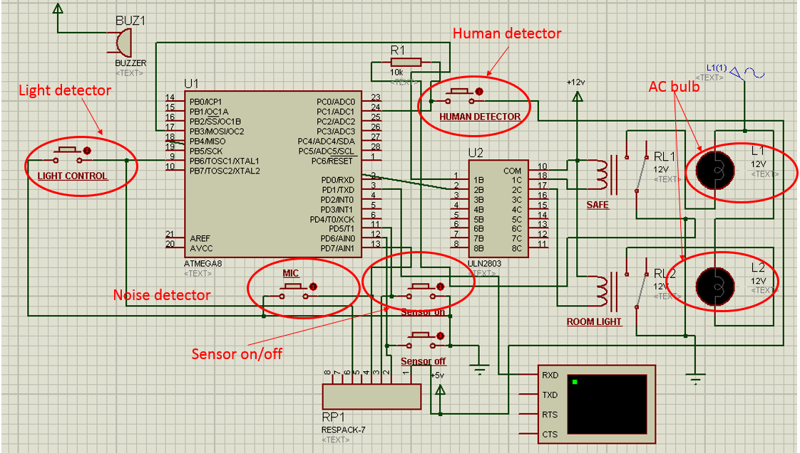
Simulation

Slide 13
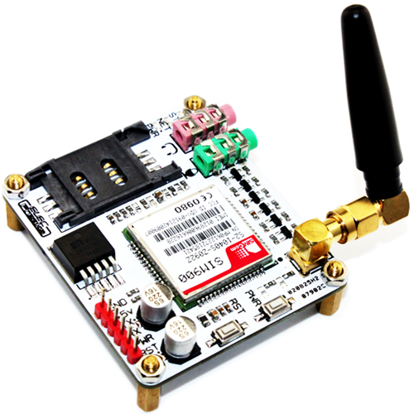
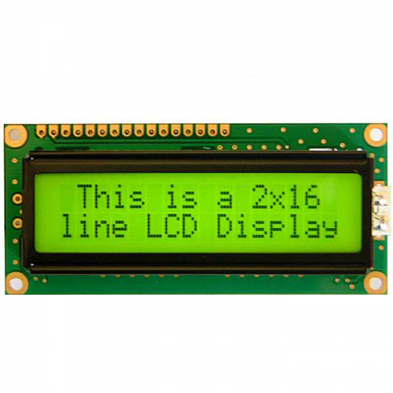
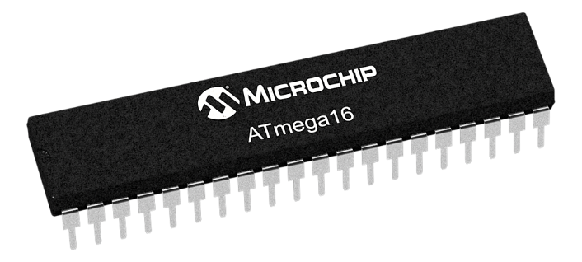

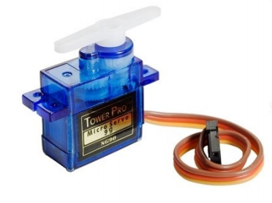
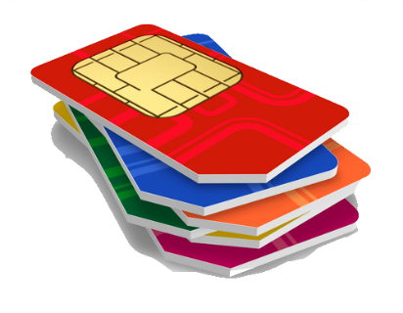
Required Hardware's
Atmega 16 Controller
GSM Module
LCD Display
Web Came
Fingerprint Pad
GSM SIM
Alarms
Servo Motor

Slide 14
AVR Studio
Microcontrollers AVR is a family of microcontrollers developed by Atmel beginning in 1996`
The Device Programming window (also known as the programming dialog), gives us the most low-level control over the debugging and programming tools. With it, you can program the device's different memories, fuses and lockbits, erase memories and write user signatures. It can also adjust some of the starter kit properties such as voltage and clock generators.

Slide 15
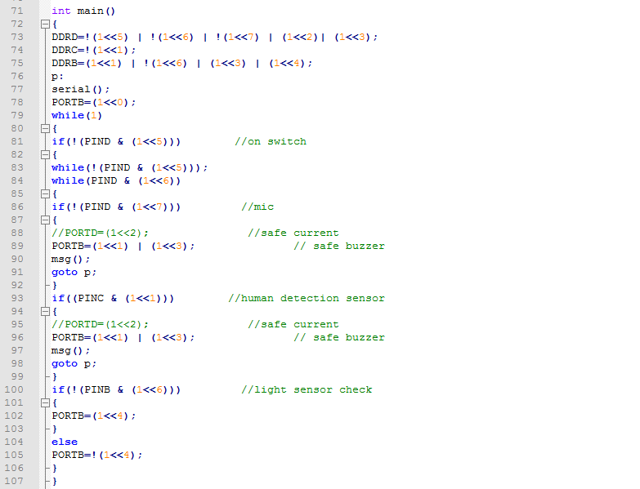
Coding Section

Slide 16
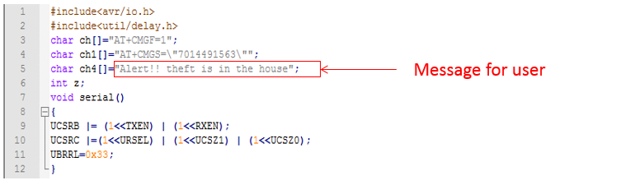
Coding Section for User

Slide 17
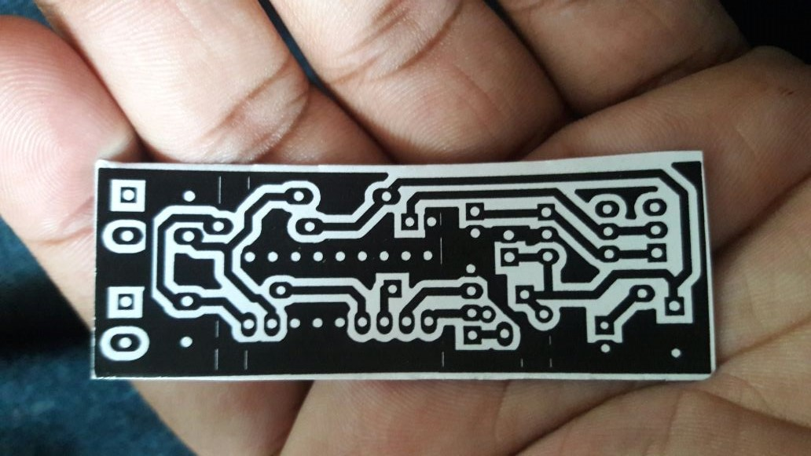
PCB Layout of Transmitter Section

Slide 18
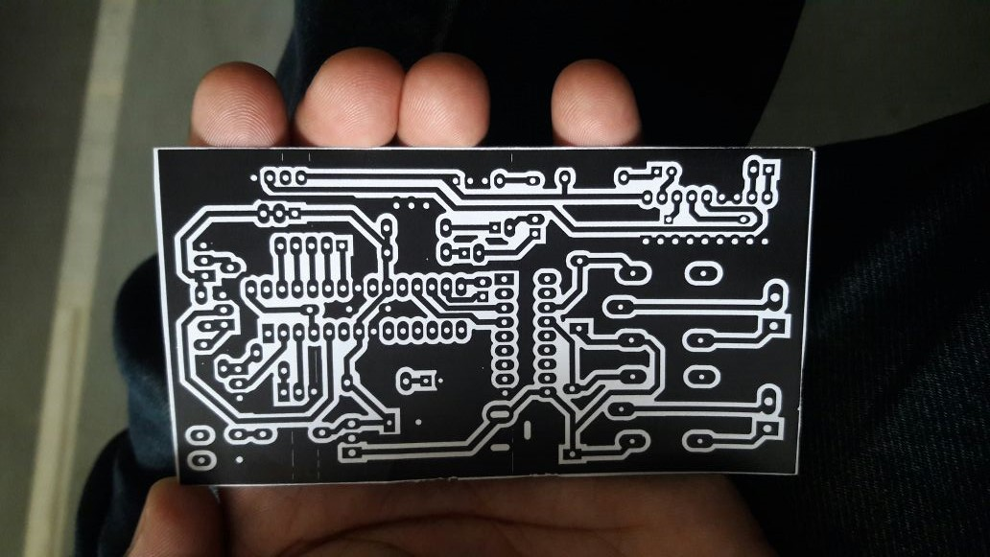
PCB Layout of Atmega 8 Section

Slide 19
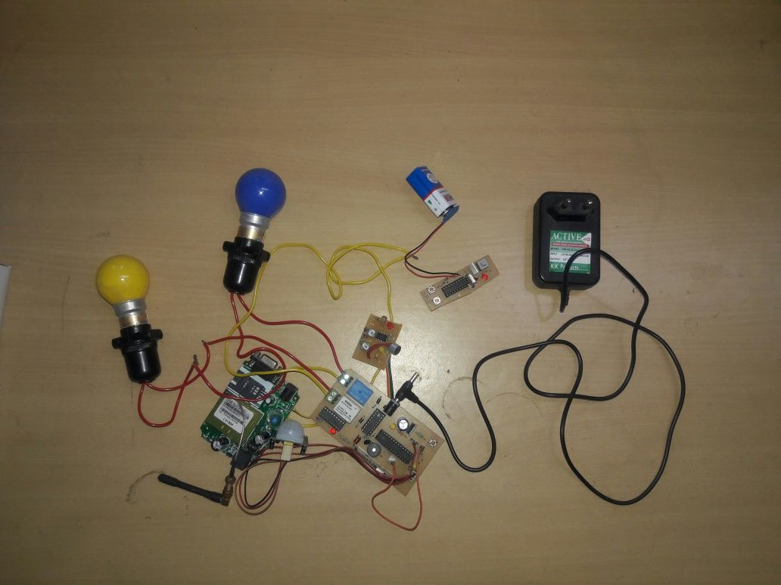
Hardware of Theft Detection Unit

Slide 20
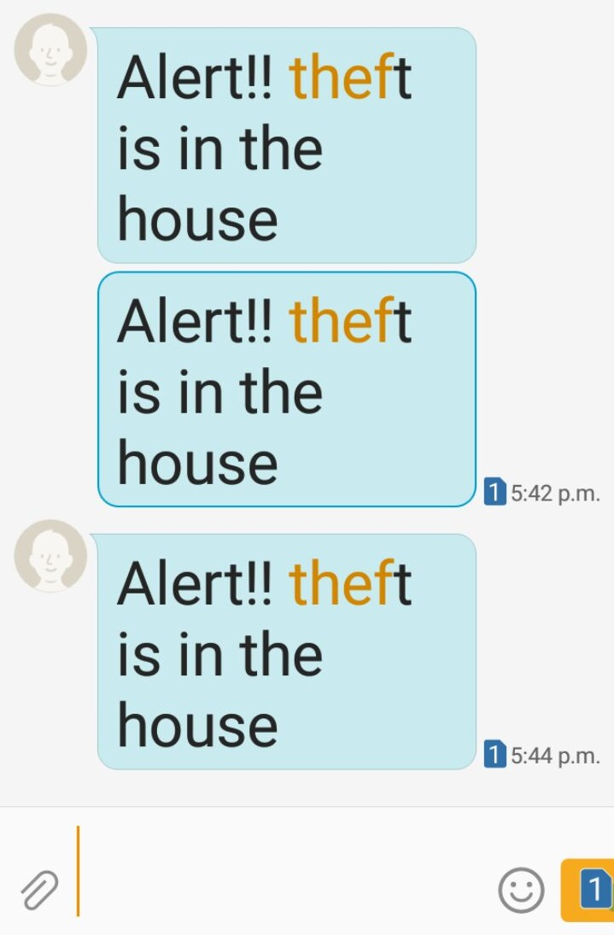
Result
Figure shows the screenshot of the message for the theft detector operation. The user can query all records of comings and goings from the ` Log (Access Record)' menu.

Slide 21
Conclusion
The GSM and IOT based advance security system has been designed and tested with the mobile network.
The user can get alerts anywhere through the GSM technology thus making the system location independent.
The web camera based security system is very easy, user friendly and software has many features.
By installing the web camera at the door site, intruder can be detected and owner can receive a message telling the intruder entry in a home.

Slide 22
References
Yanbo Zhao , Zhaohui Ye "A low cost GSM/GPRS based wireless home security system" IEEE Transactions on Consumer Electronics ( Volume: 54, Issue: 2 ),2008.
C. Pyo, H. Gang, N. Kim and H. Bang, \Technology trends and prospects of development of IoT (M2M)," OSIA Standards & Technology Review, vol. 26, no. 2, (2013), pp. 8-17.
Y. Ko, \Study of Policies of Major Countries on Internet of Things and Market Forecast," In ternational Commerce and Information Review, vol. 16, no. 5, (2014),pp. 27-47.
D. Seo, H. Ko and Y. Noh, \Design and Implementation of Digital Door Lock by IoT," KIISE Transactions on Computing Practices (KTCP), vol. 21, no. 3, (2015), pp. 215-222.

Slide 23
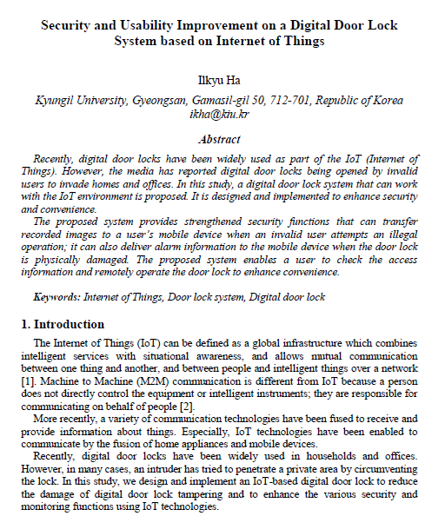

Slide 24
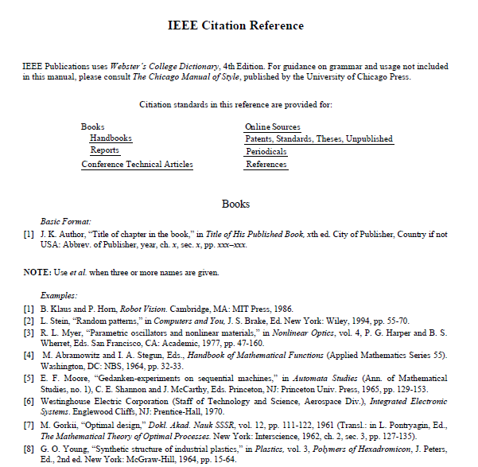

Slide 25
Thank You

